Slide 1

Receipt classes

Slide 2
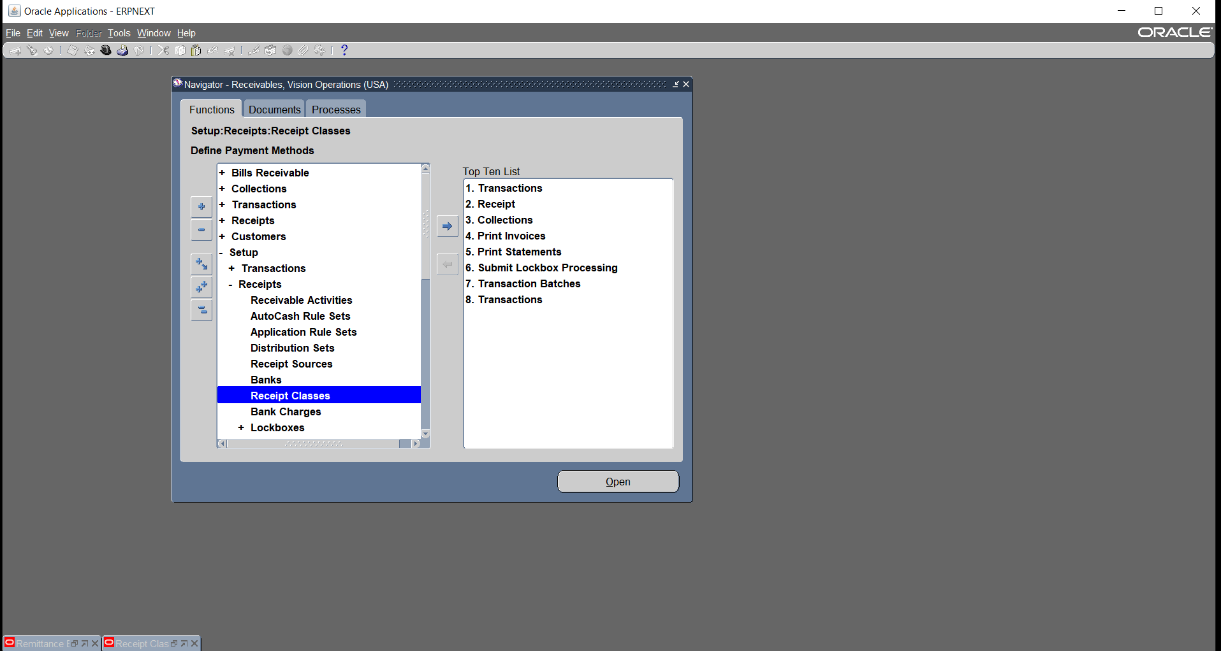
Setup > receipts > receipt classes

Slide 3
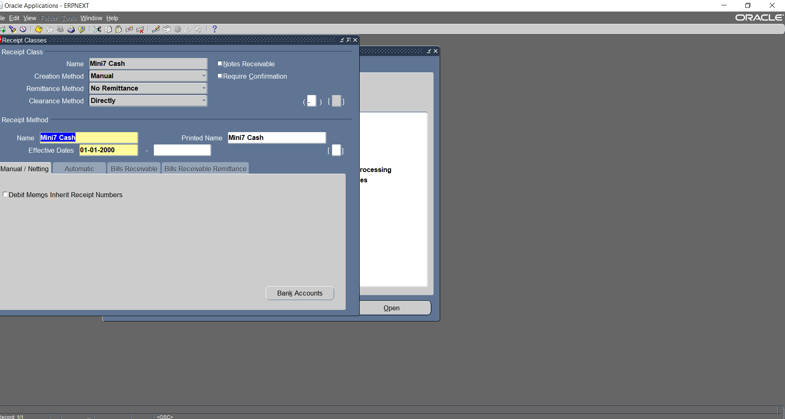
We name receipt class and receipt method

Slide 4
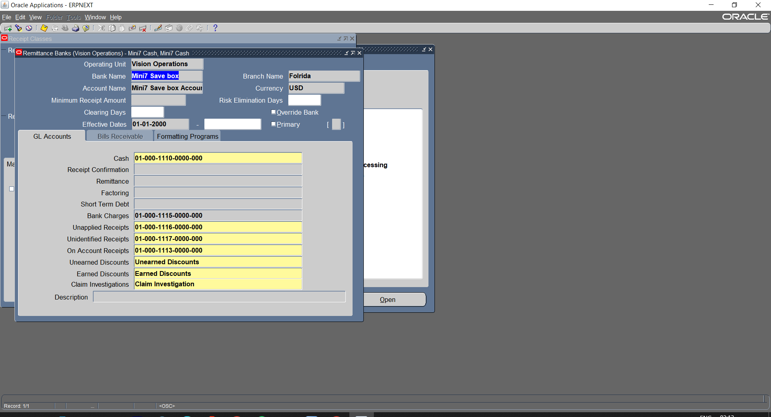
We Link our Bank and add all accounts then we save

Slide 5
Setup > receipts > receipt classes

Slide 6
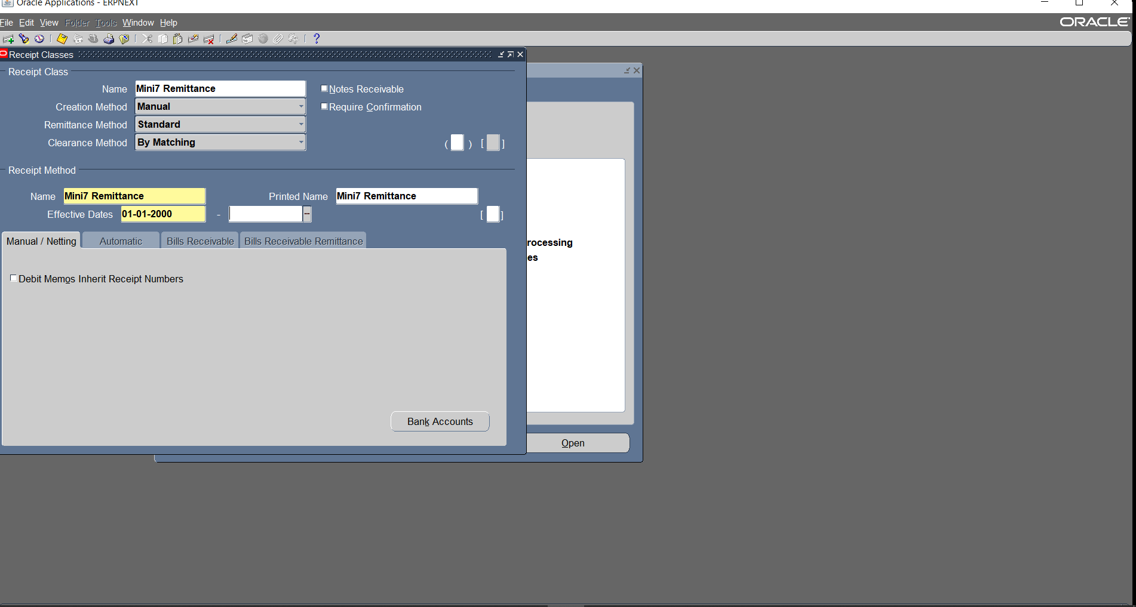
We name receipt class and receipt method

Slide 7
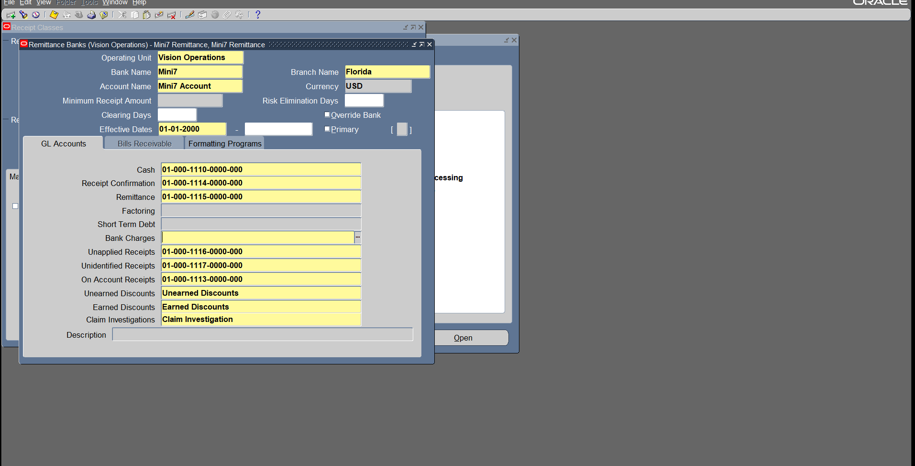
We Link our Bank and add all accounts then we save

Slide 8
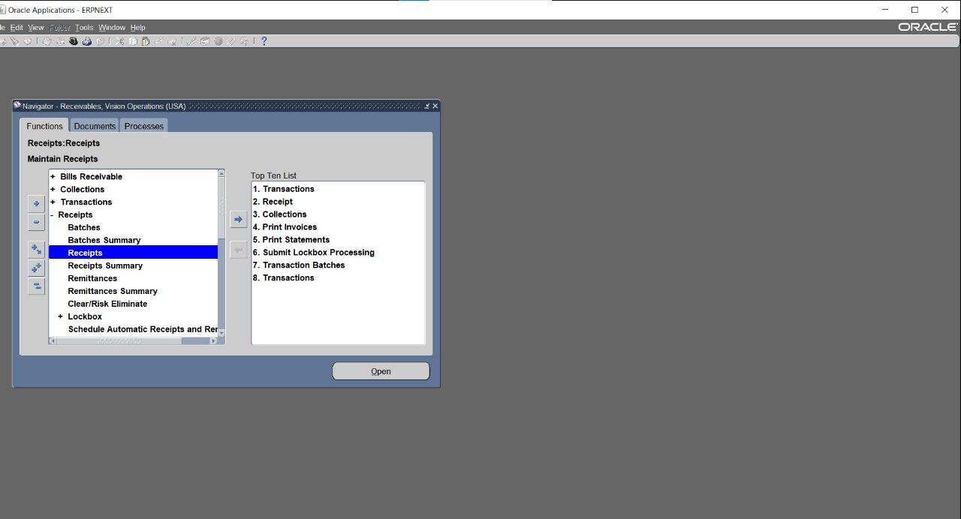
Receipt : From menu Receipts choose function Receipts

Slide 9
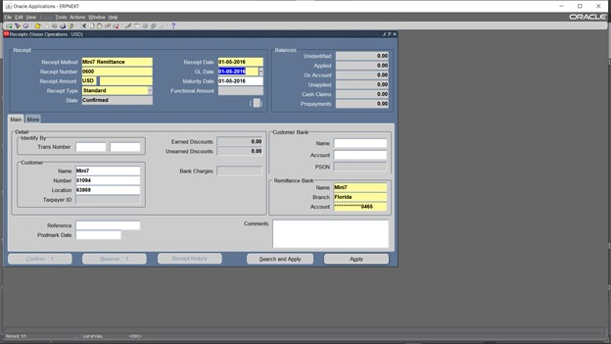
Choose receipt method ,date , amount and customer name then click apply

Slide 10
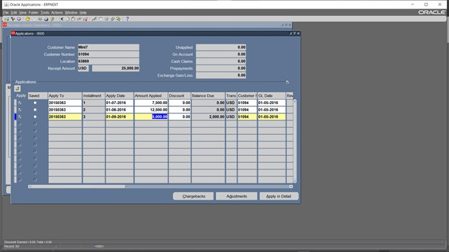
Choose the invoices then ctrl+s to save them then click apply in detail

Slide 11
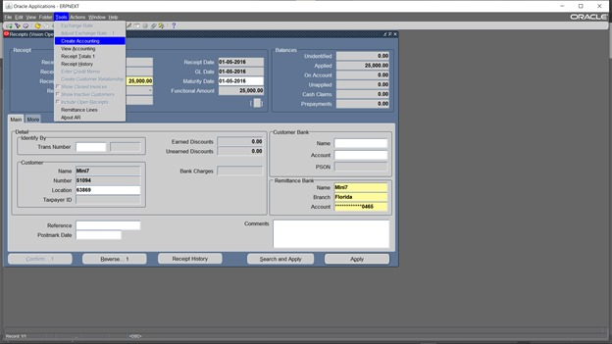
tools >create accounting

Slide 12
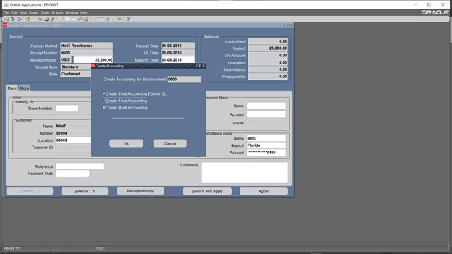
create final accounting then tools > view accountig

Slide 13
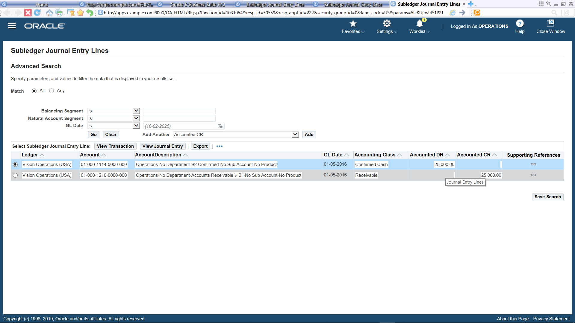
From tools choose view accounting

Slide 14
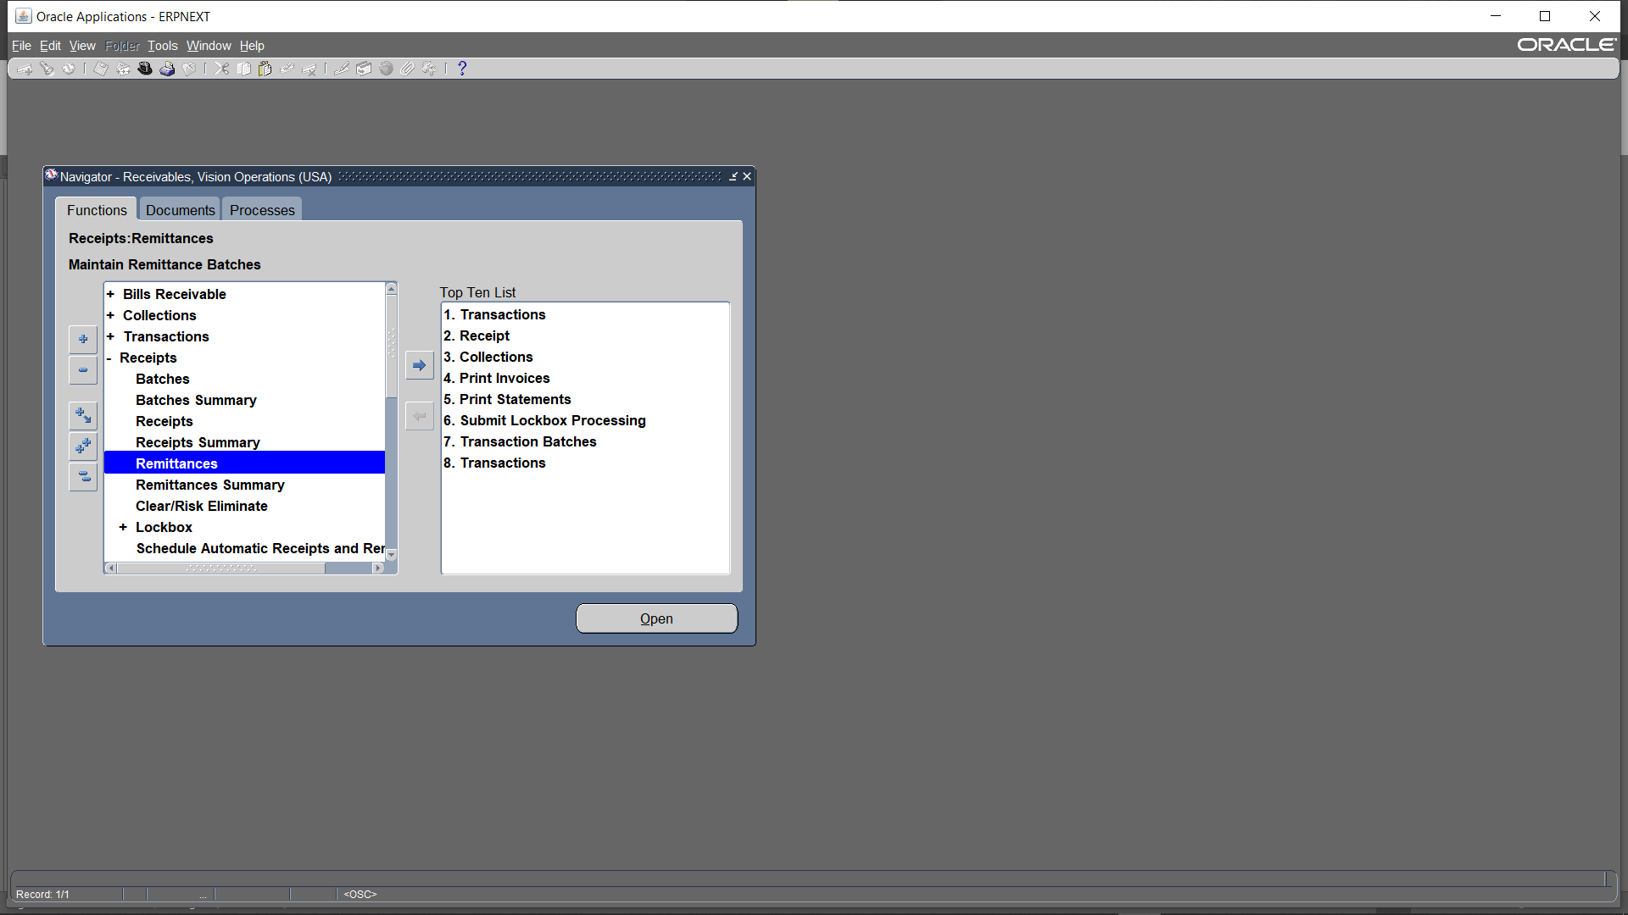
To change the State of receipts from CONFIRMED to REMITTED Click Receipts >> Remittances

Slide 15
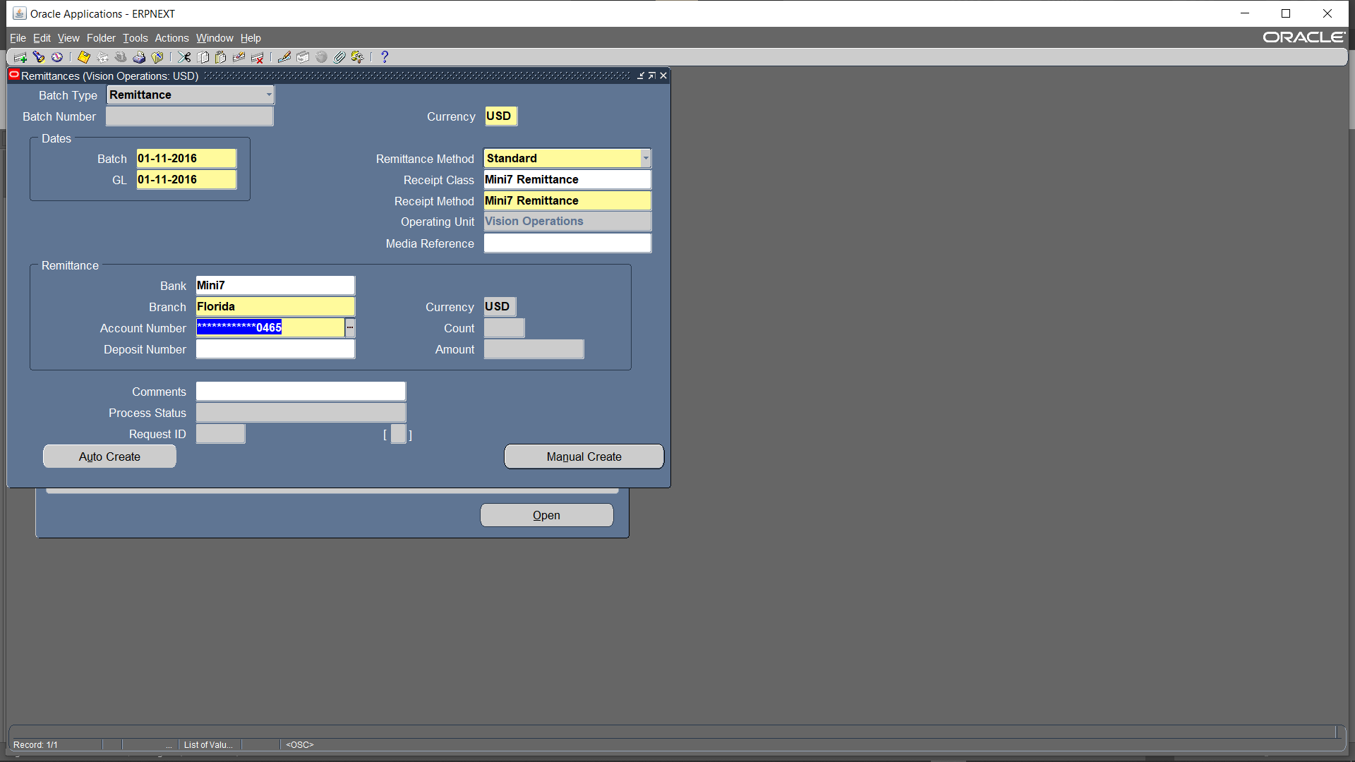
Enter the batch and GL dates, select the receipt method and receipt class, and then enter the bank details, including the branch and account number where the funds were received. click Manual Create

Slide 16
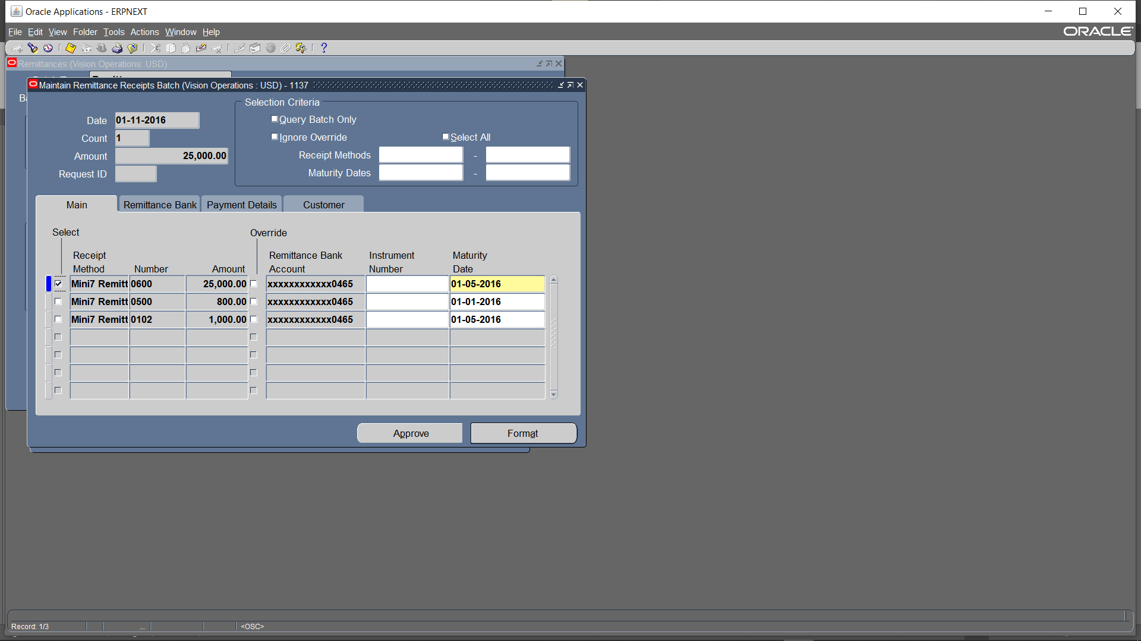
Press Ctrl + F11 to search for the receipts you want to remit. Click on Format to finalize the remittance details

Slide 17
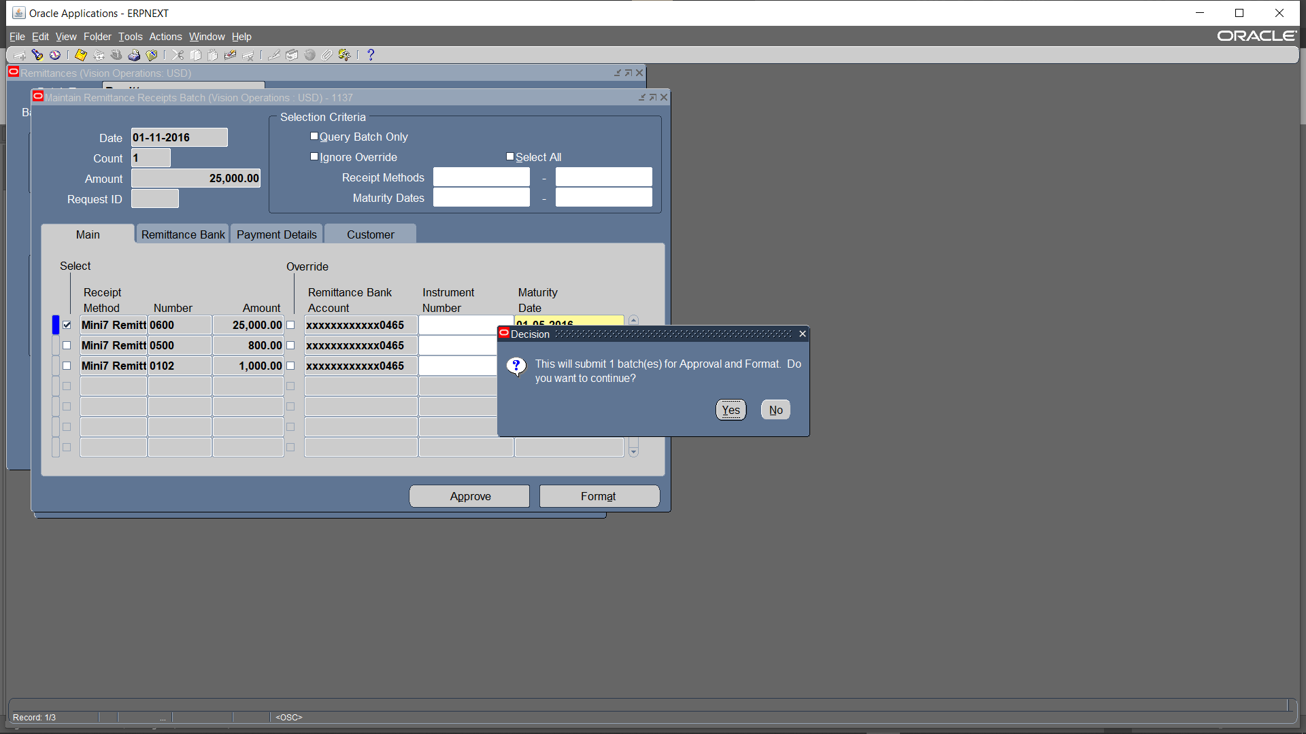
Click Yes

Slide 18
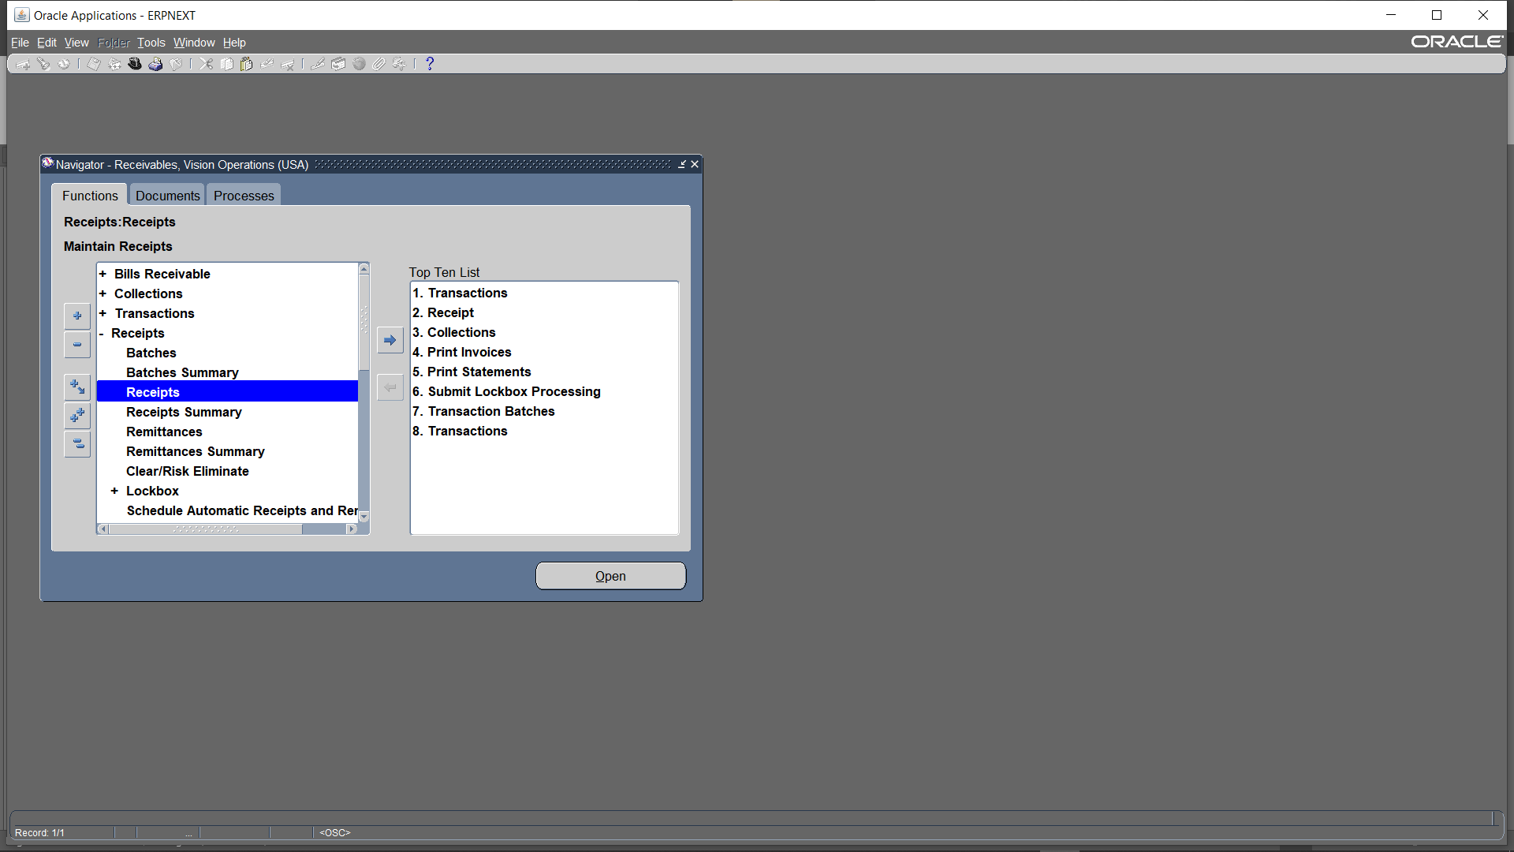
Receipts > Receipts

Slide 19
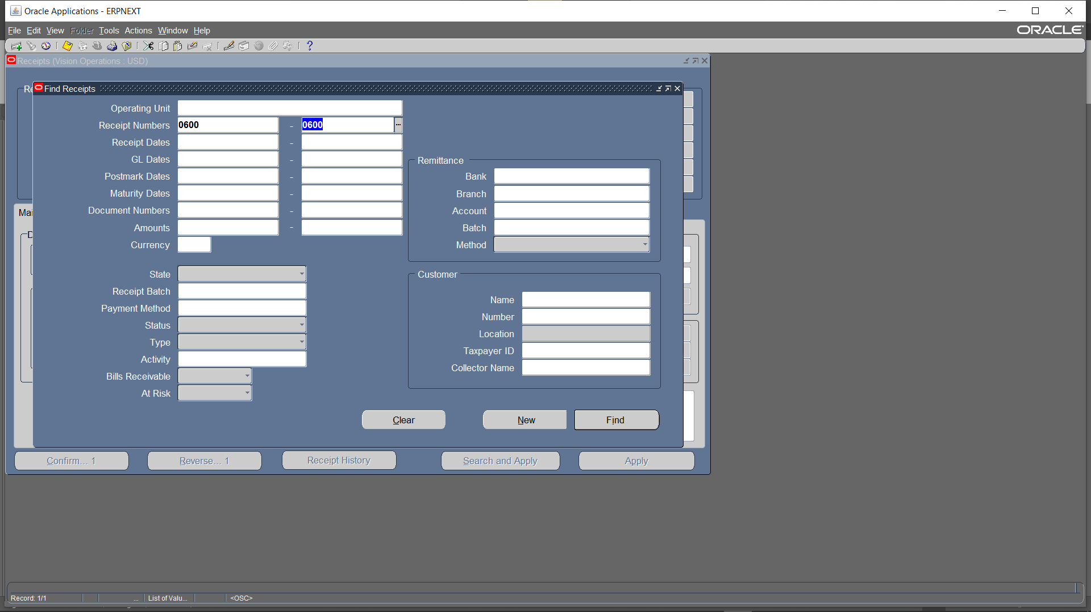
Search for the receipt

Slide 20
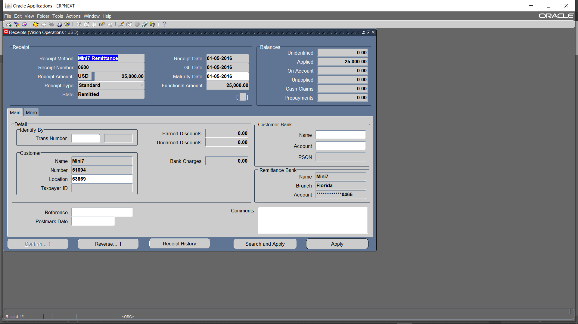
You will find that the State has been updated to REMITTED

Slide 21
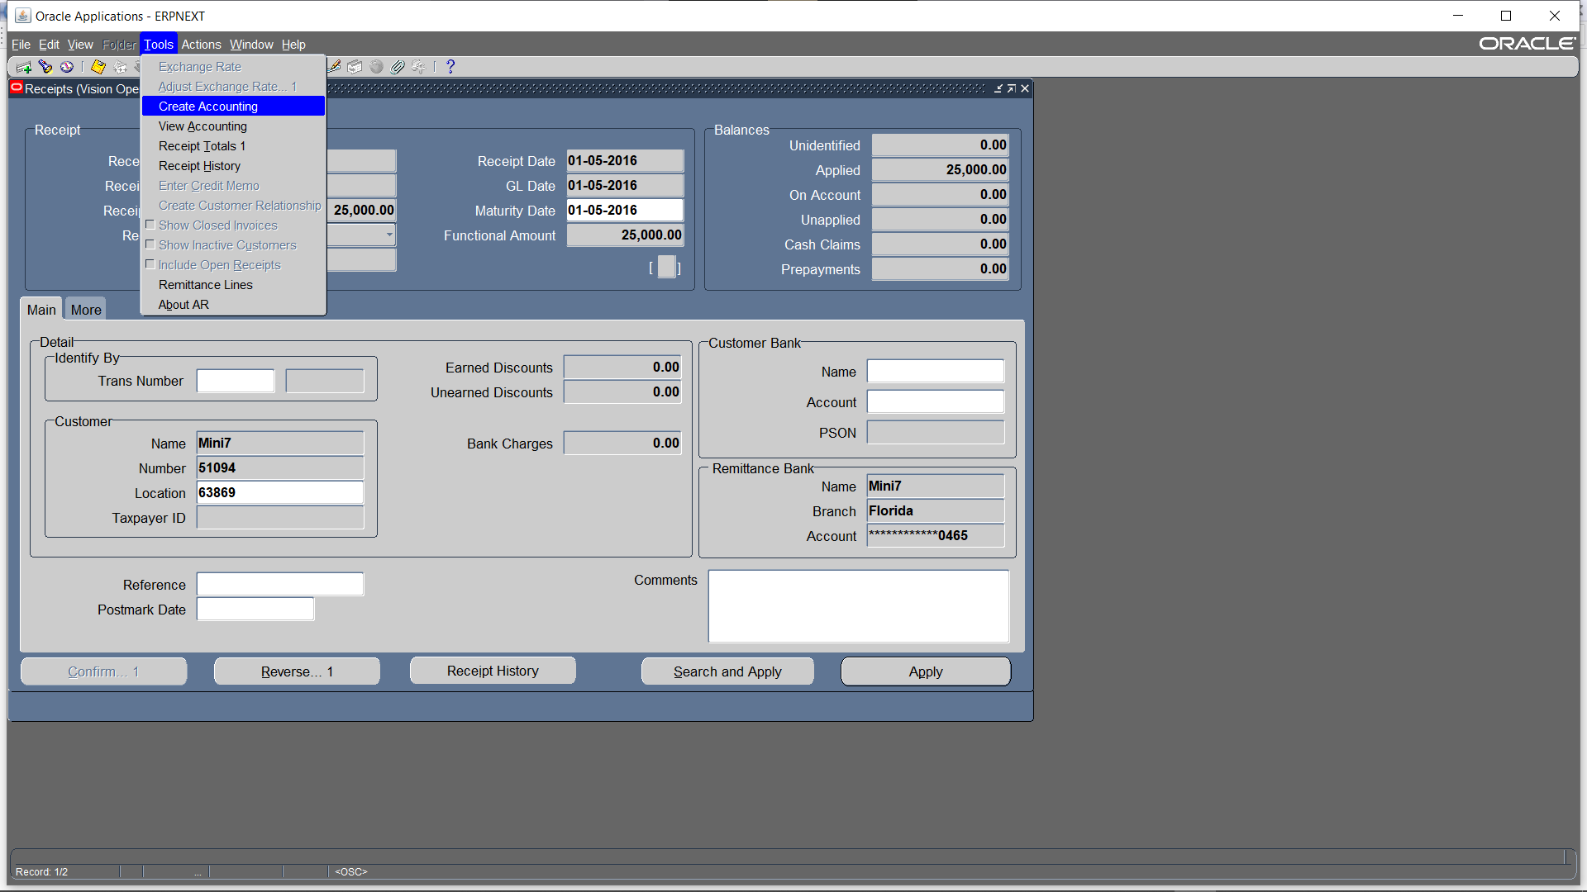
TOOLs > Create Accounting

Slide 22
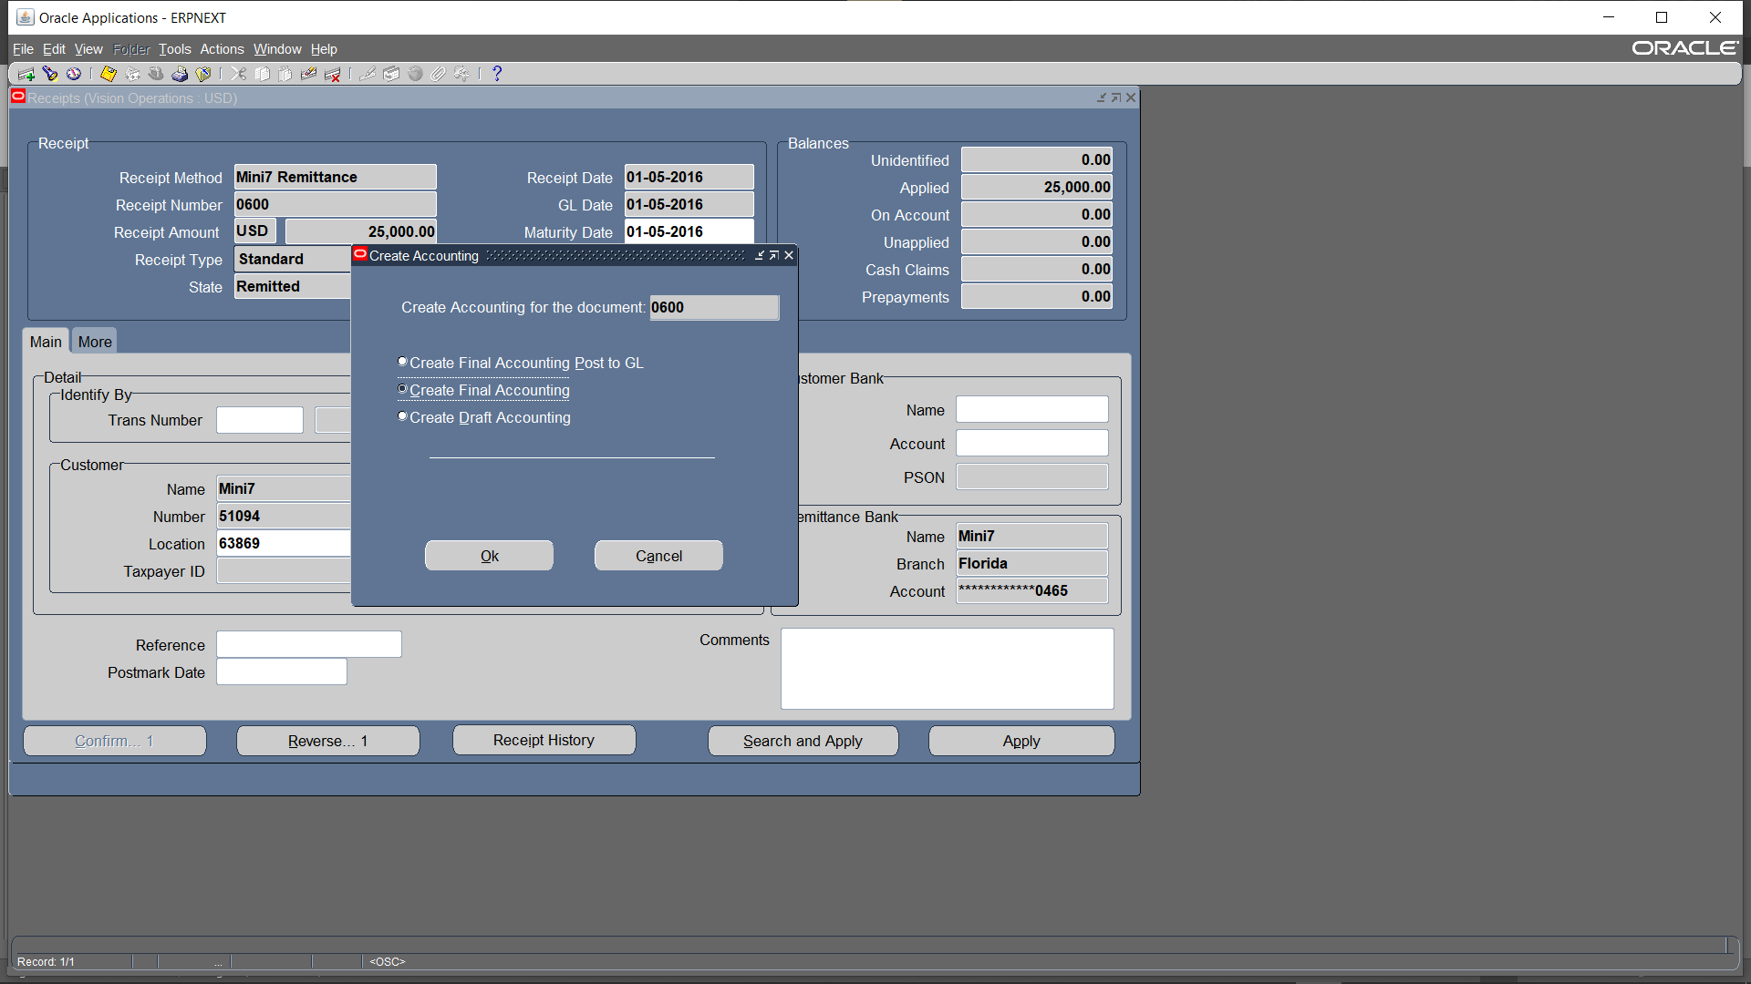
Create final accounting >> ok

Slide 23
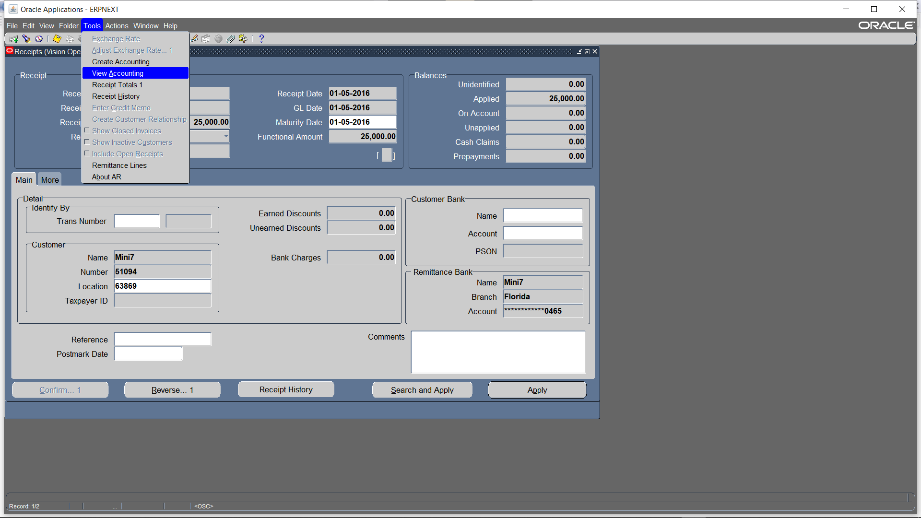
Tools > view accounting

Slide 24
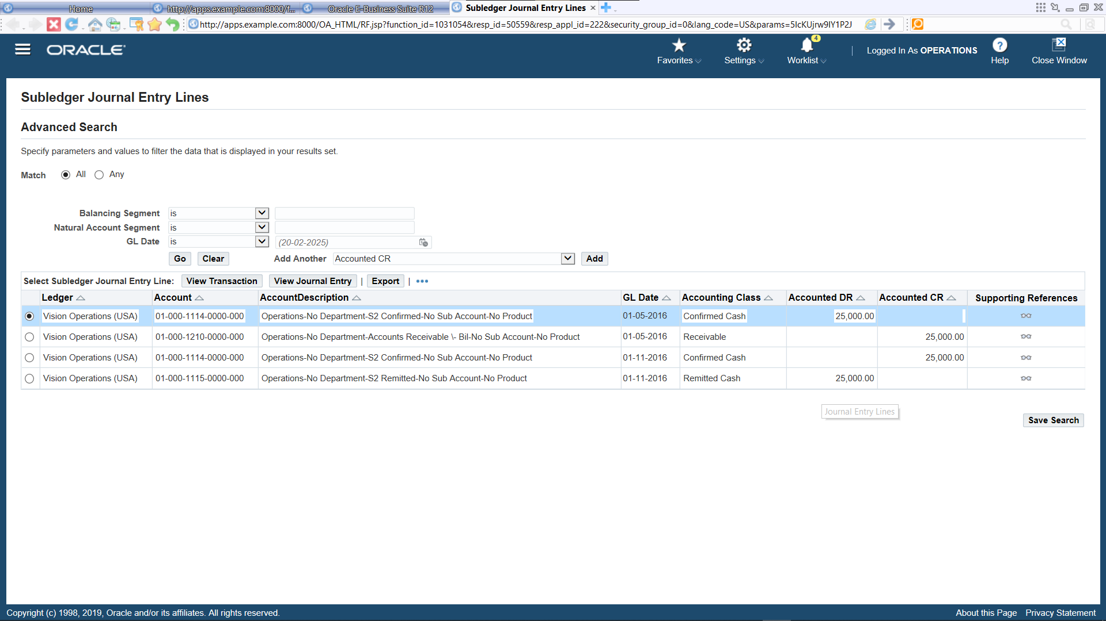
"Initially, when receipts are applied to an invoice, the journal entry is recorded as Confirmed Cash (Debit) and Receivables (Credit). Once transferred to remittance, the entry updates to Remitted Cash (Debit) and Confirmed Cash (Credit)."

Slide 25

On Account

Slide 26
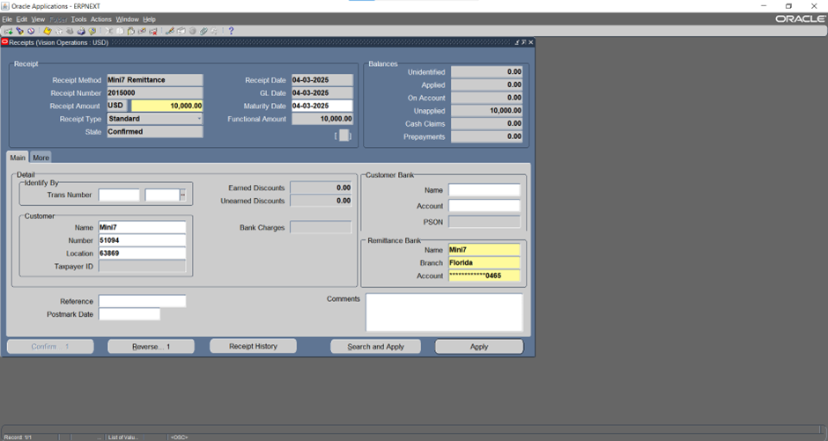
Choose receipt method ,date , amount and customer name then click apply

Slide 27
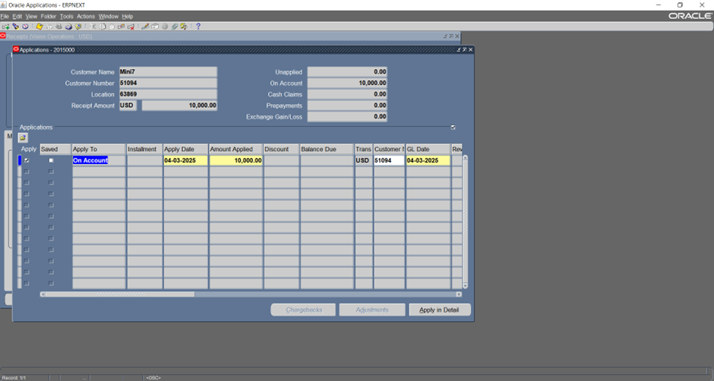
Apply amount On Account Then Ctrl+S to save

Slide 28
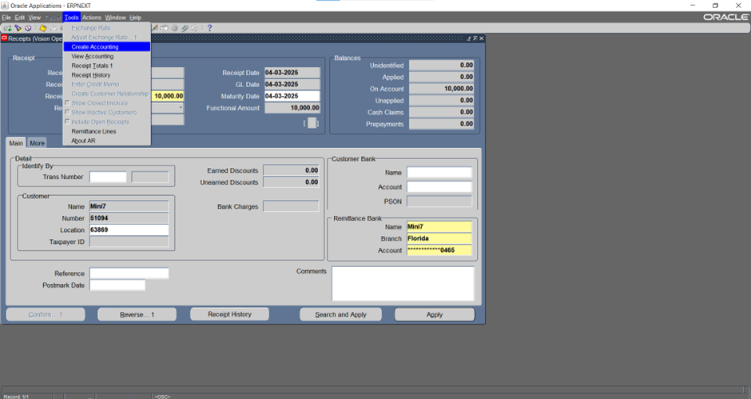
TOOLS > create accounting

Slide 29
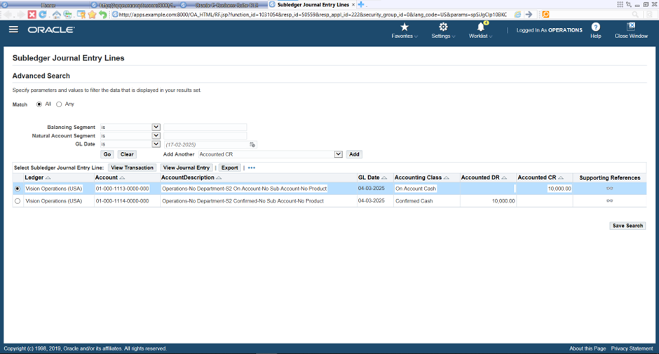

Slide 30
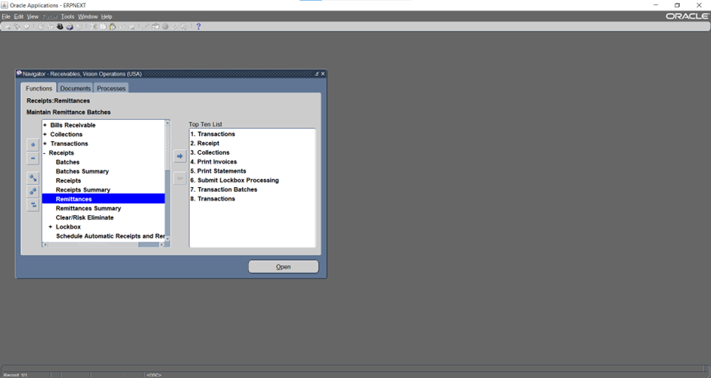
To change the state of receipts from CONFIRMED to REMITTED click receipts >> remittances

Slide 31
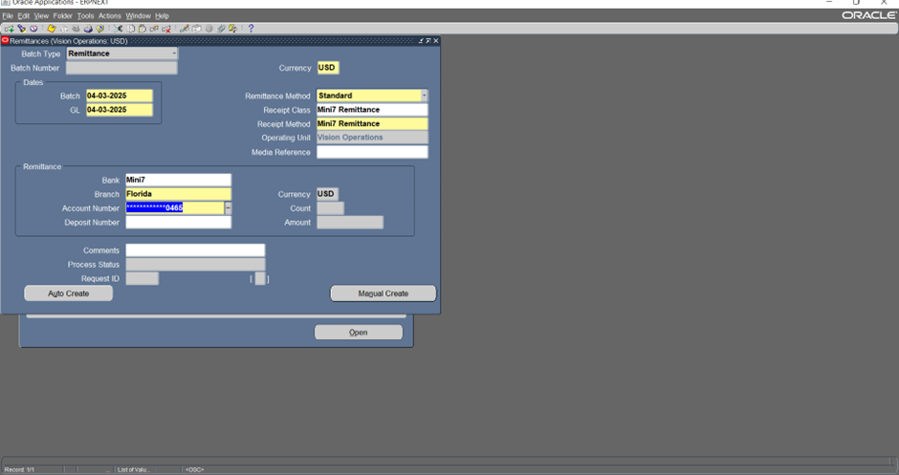
Enter the batch and GL dates, select the receipt method and receipt class, and then enter the bank details, including the branch and account number where the funds were received. Click manual create

Slide 32
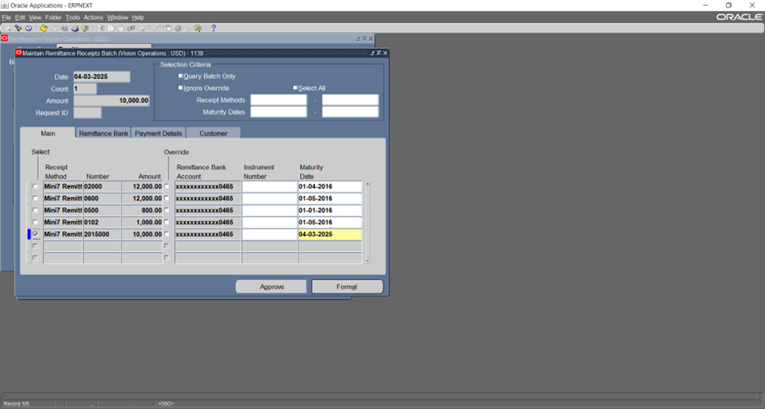
Press ctrl + F11 to search for the receipts you want to remit. Click on format to finalize the remittance details

Slide 33
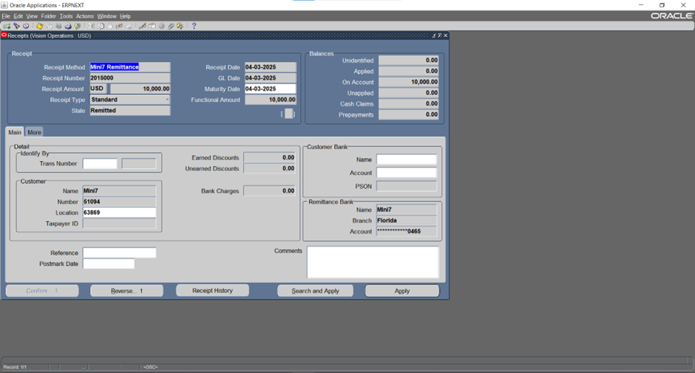
You will find that the state has been updated to REMITTED

Slide 34
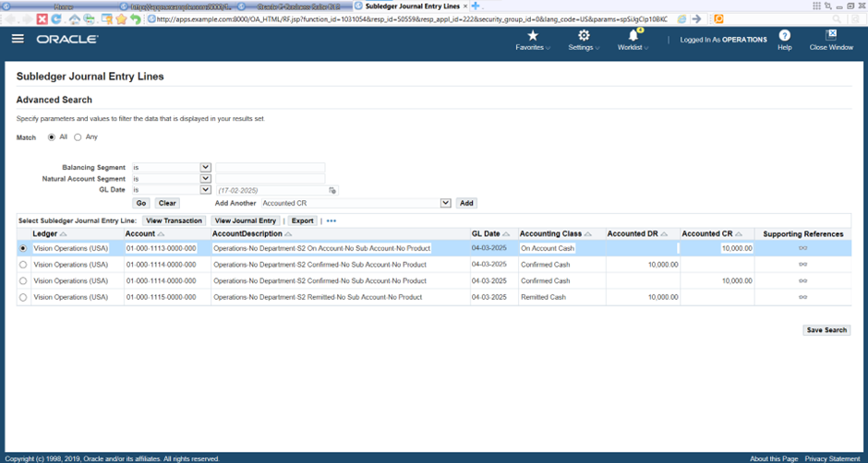

Slide 35
REFUND

Slide 36
Receipts > receipts

Slide 37
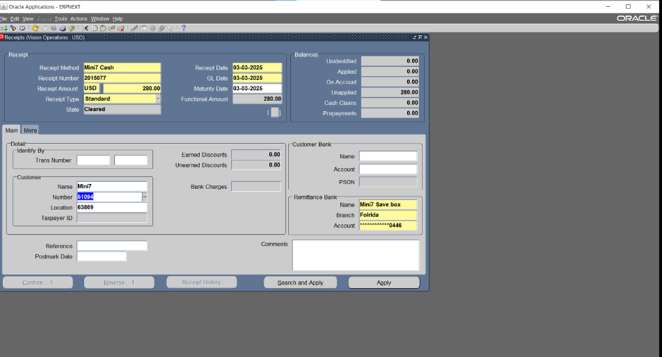
Choose receipt method ,date , amount and customer name then click apply

Slide 38
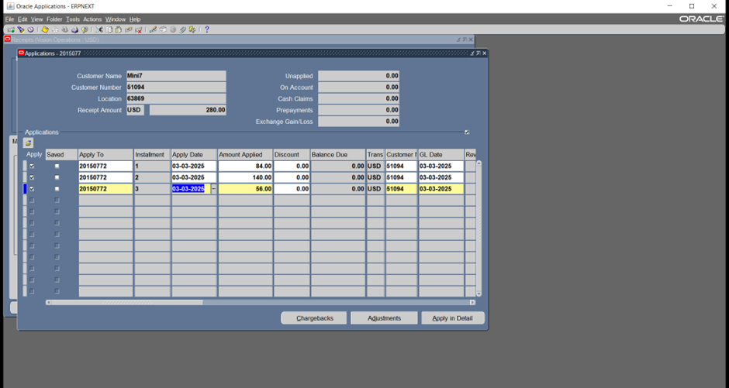
Choose the invoices then ctrl+s to save them then click apply in detail

Slide 39
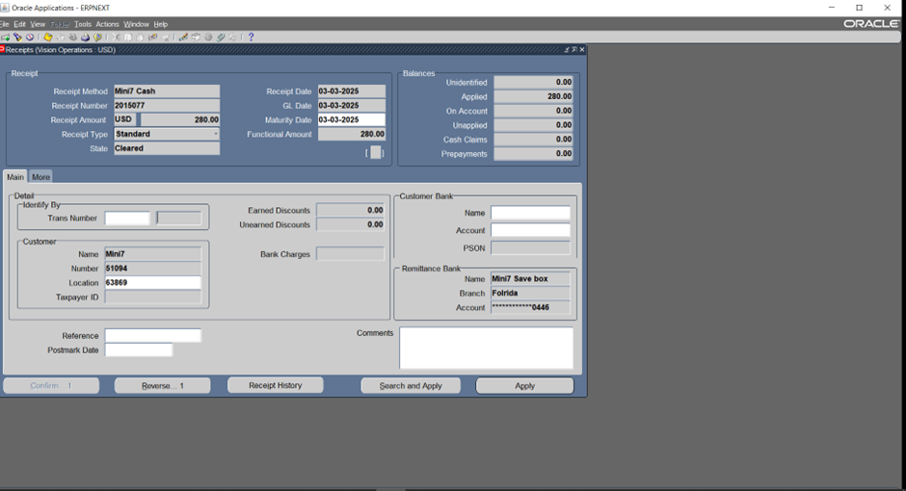
Then to Make a refund we go to apply again

Slide 40
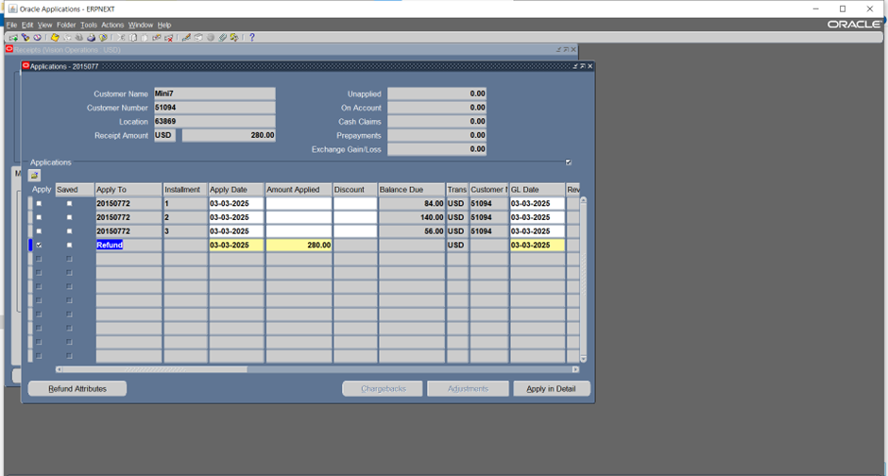
Apply amount to refund then ctrl+s to save then click on refund attributes to select money refund method

Slide 41
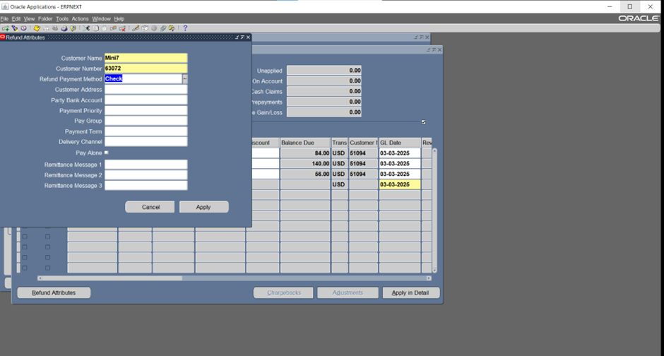
Then we choose to pay with checks then we click on apply

Slide 42
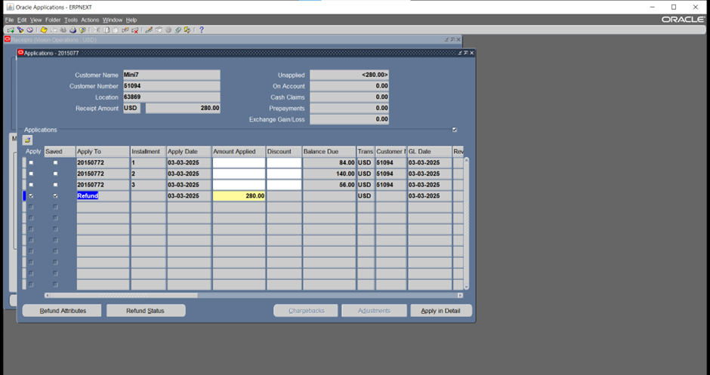
Unapplied amount turns negative

Slide 43
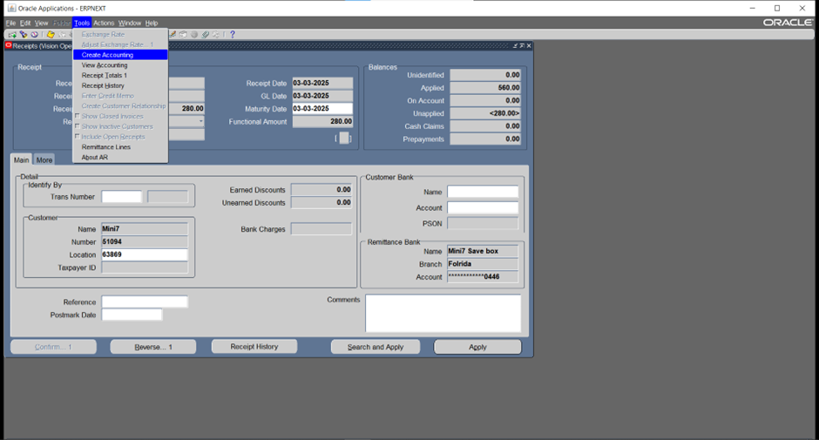
Then we create account

Slide 44
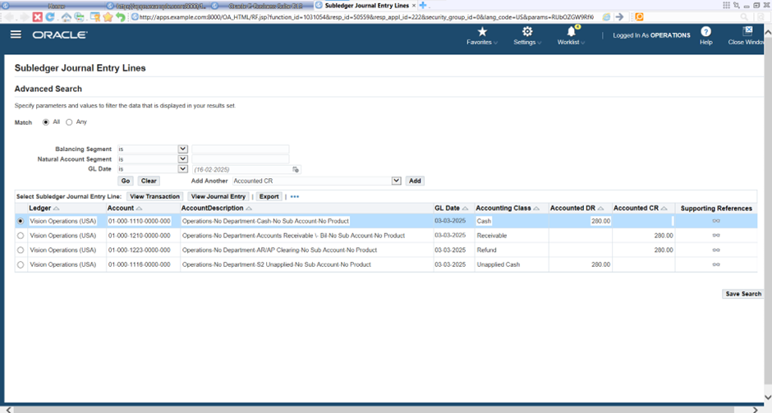

Slide 45
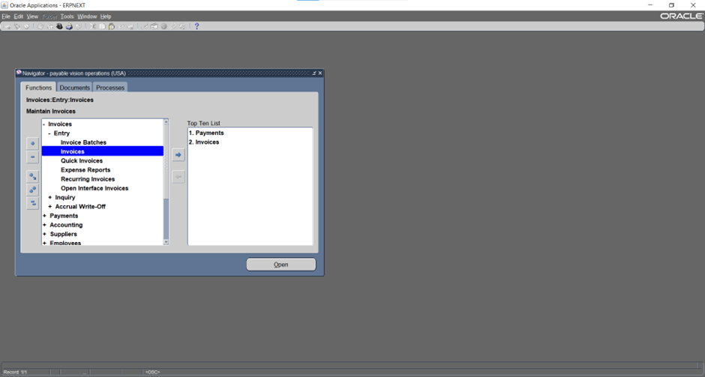
Payables > invoices

Slide 46
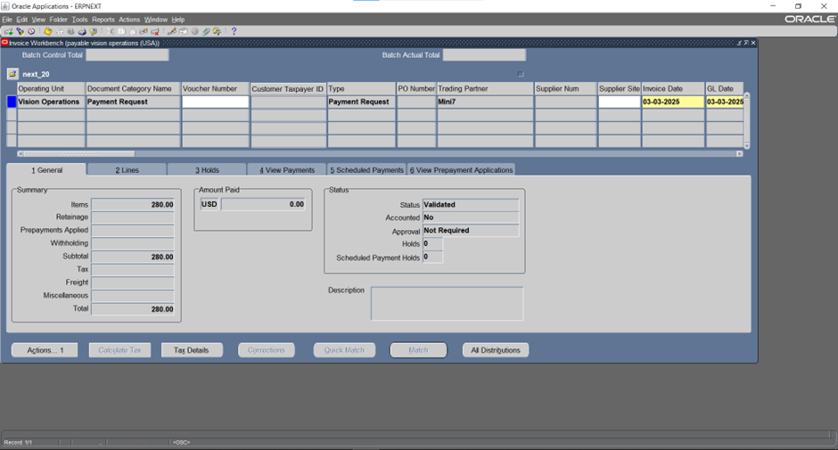
We got a payment request with the same amount of refund then we click Actions to create account

Slide 47
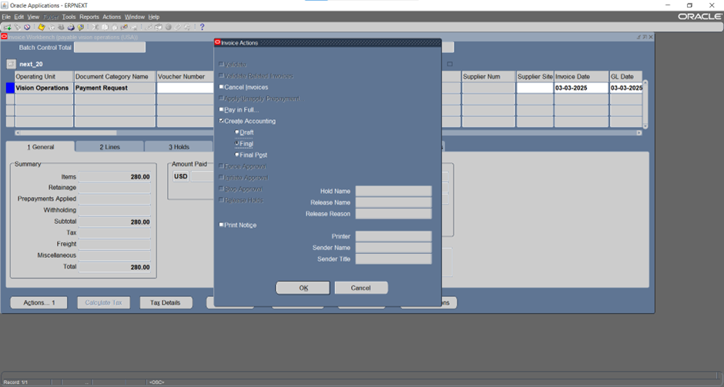
Create account >>final

Slide 48
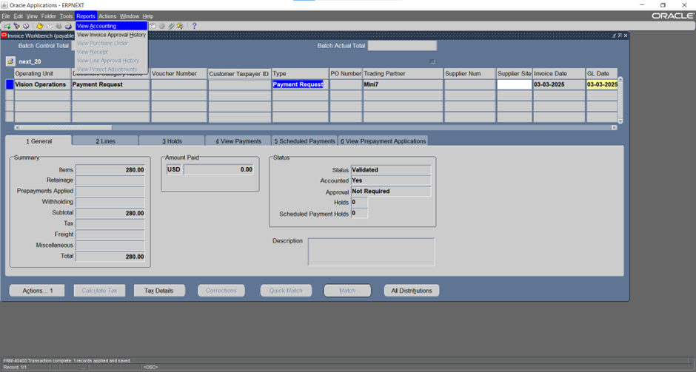
Requests > view accounting

Slide 49
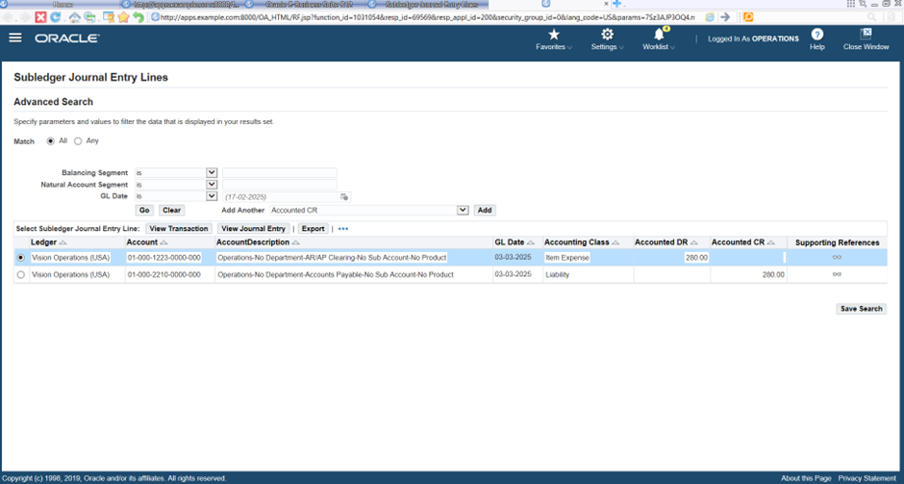

Slide 50
“write off” "A customer has had an outstanding invoice for over a year without payment. Upon learning that the individual or company has declared bankruptcy, I had to write off the amount as a bad debt."

Slide 51
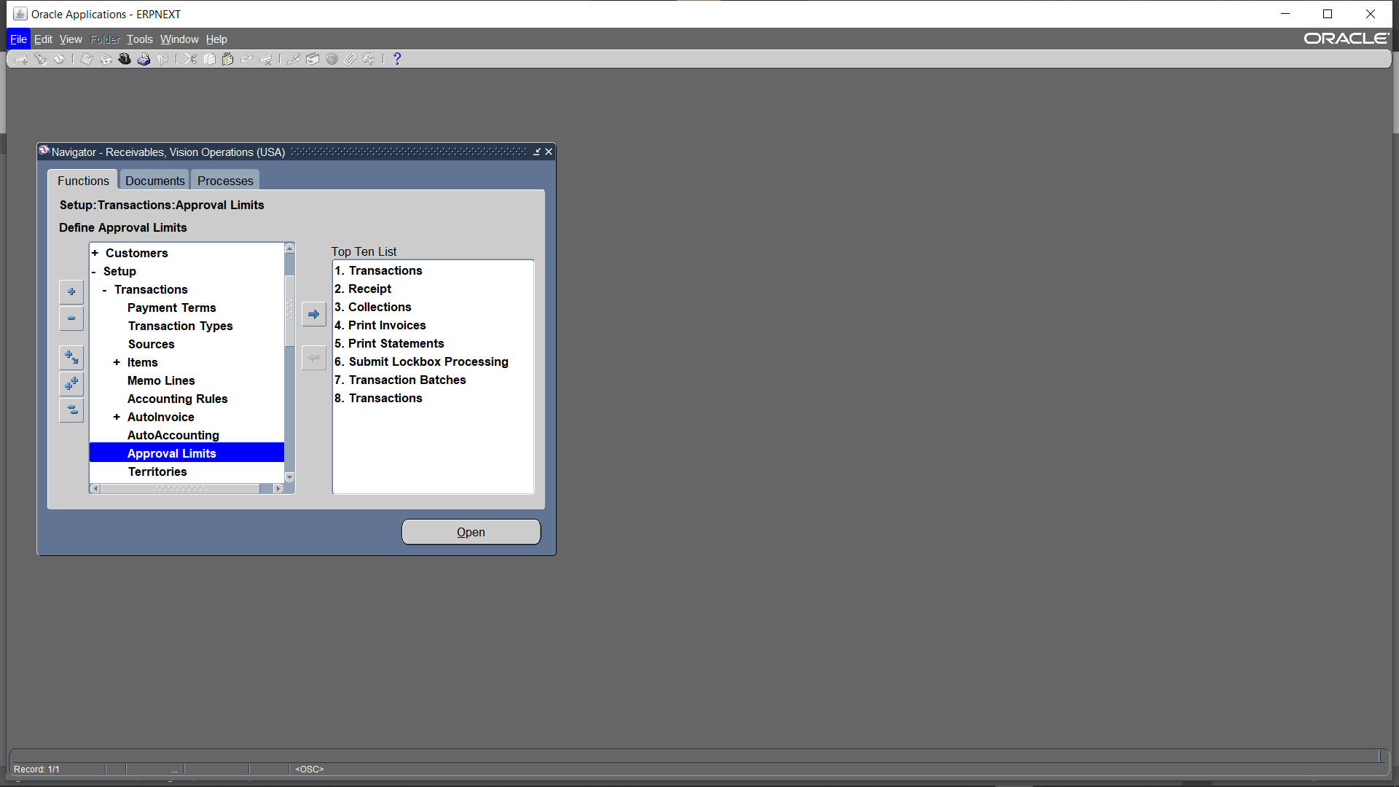
Enter approval limits setup>>Transactions>>Approval limits

Slide 52
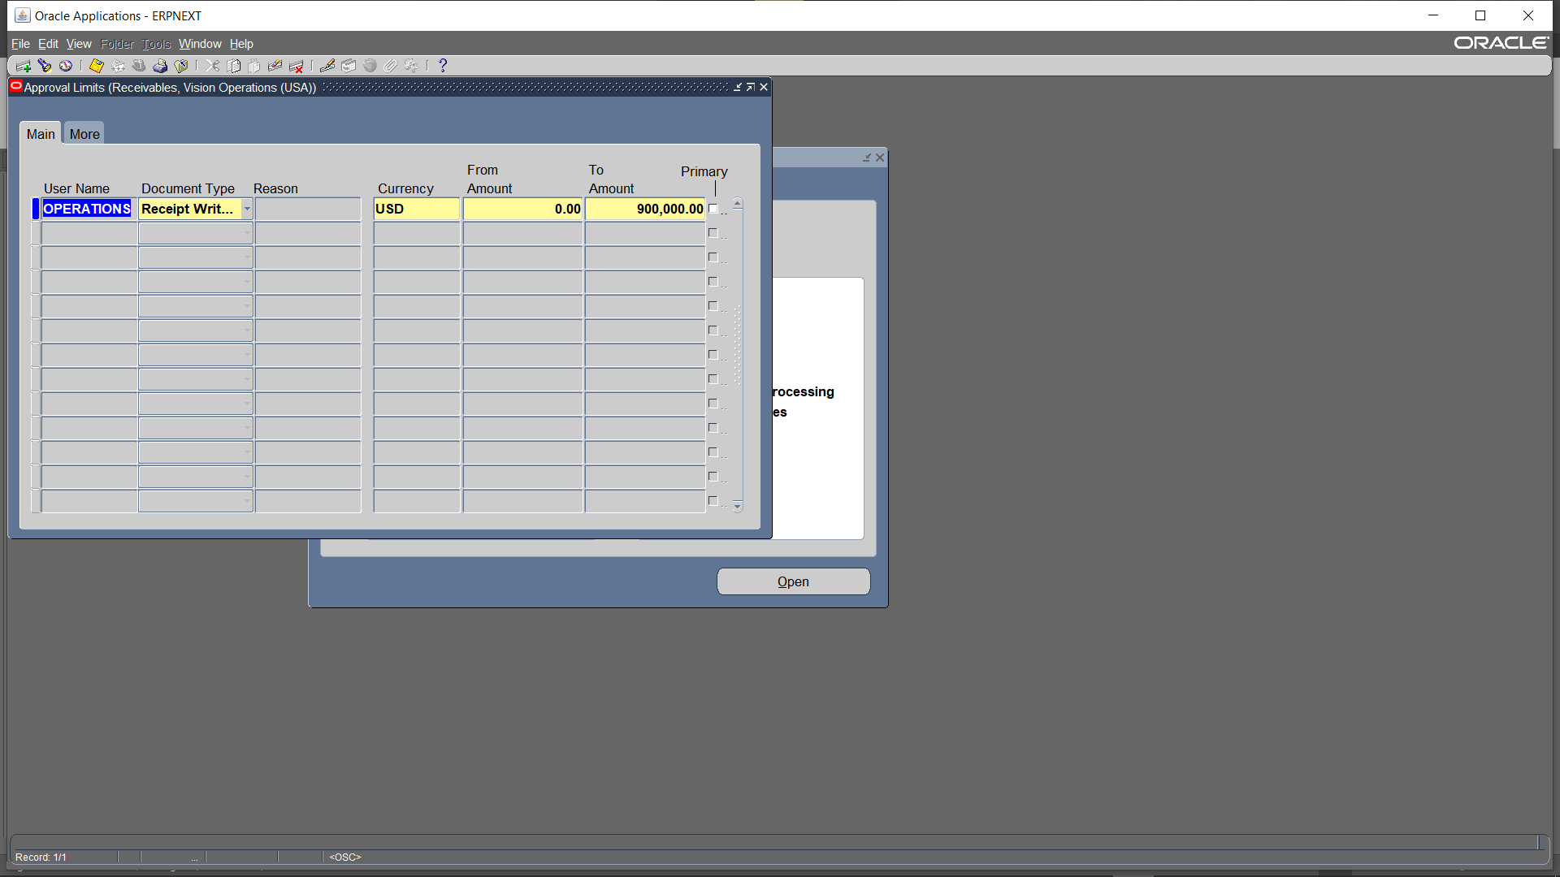
add a new approval limit for receipt write-off

Slide 53
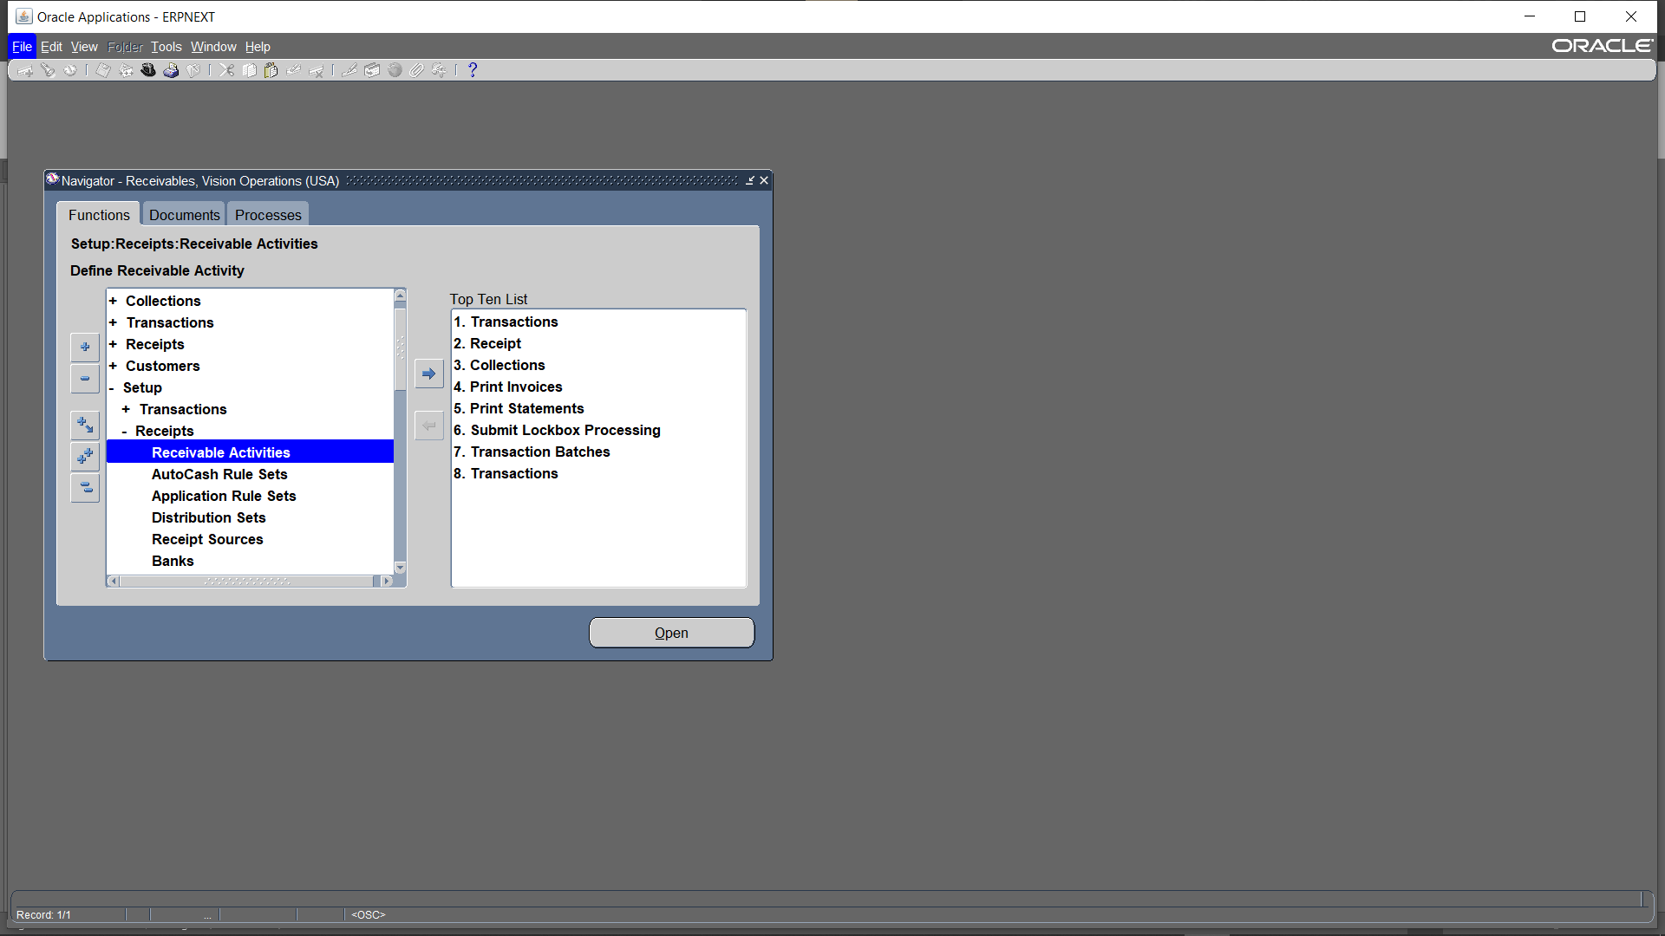
Enter Receivables activities Setup > Receipts > Receivable Activities

Slide 54
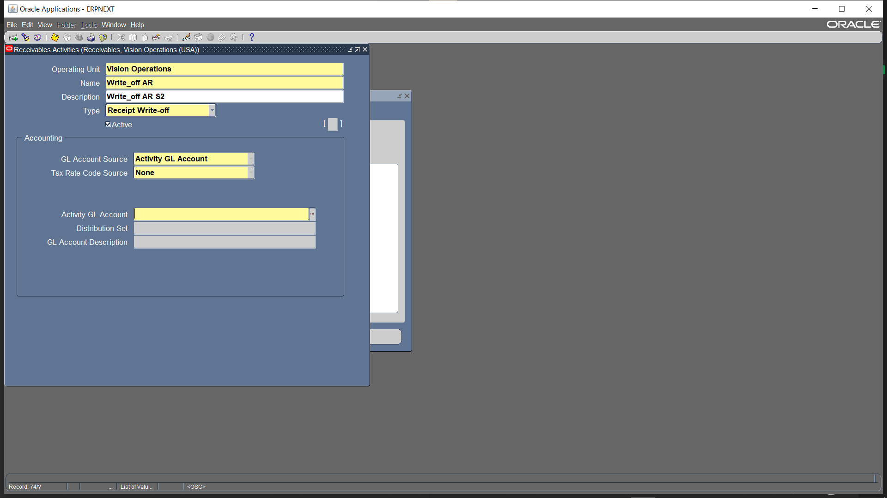
In the Receivable Activities section, enter the Name and select the Type

Slide 55
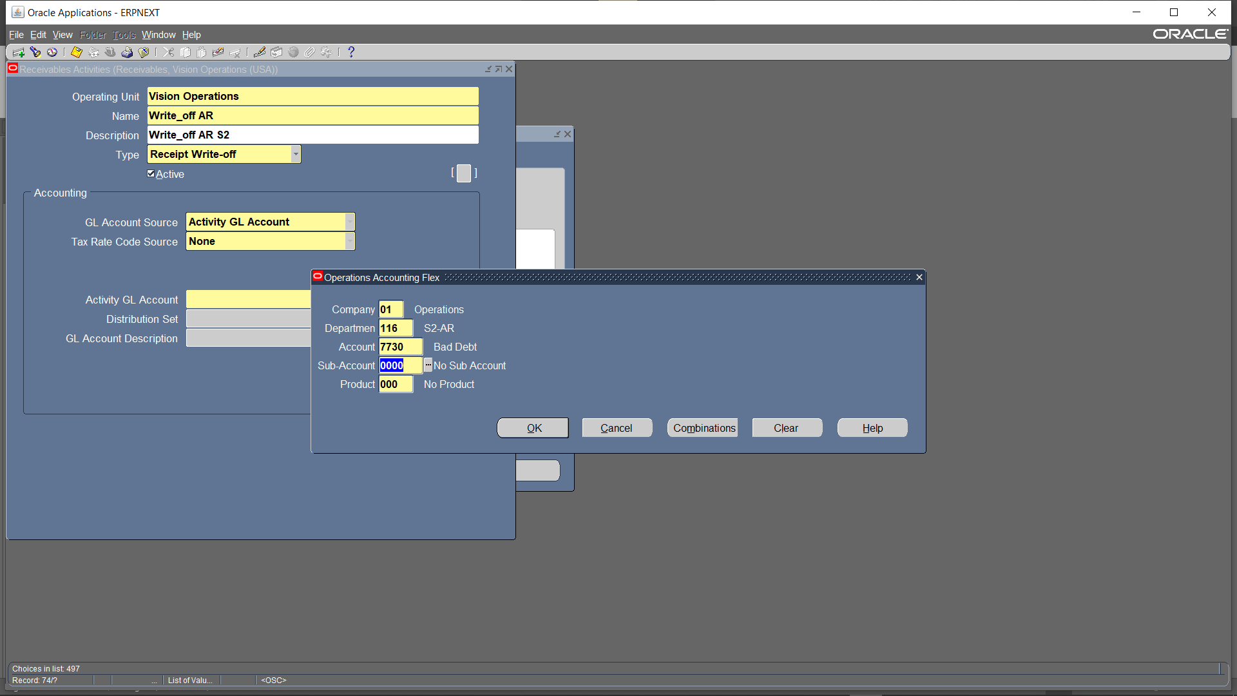
"Input the Code Combination, then specify the Bad Debts account."

Slide 56
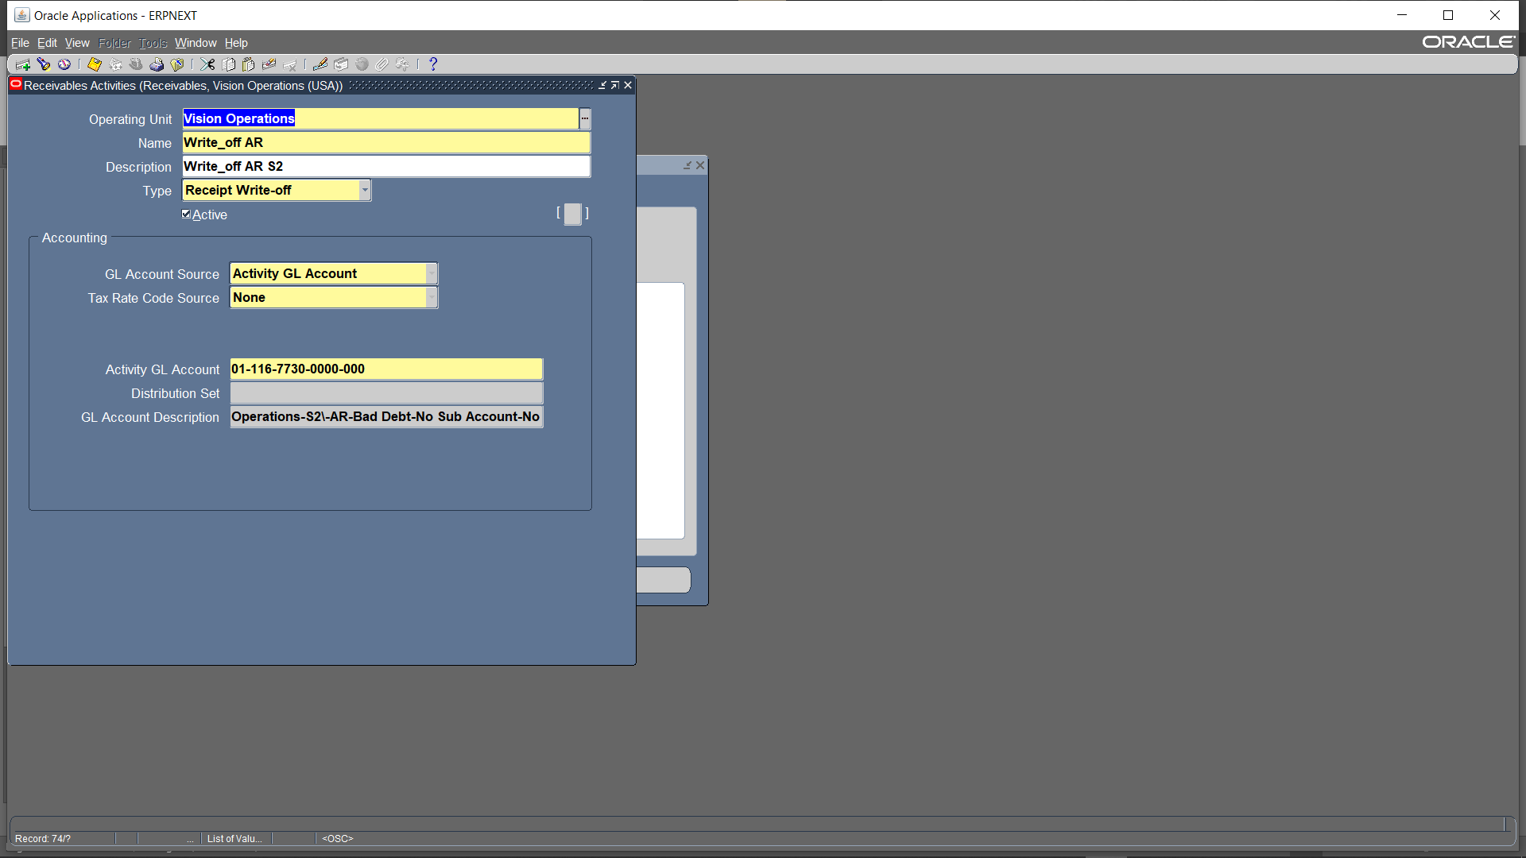
After entering the details, click Save to store the information

Slide 57

Next, navigate to Receipts to process the write-off for the outstanding amount. Receipts >> Receipts

Slide 58

"Entering the receipt details requires the following information: Receipt Method, Receipt Number, Receipt Amount, Customer, and Receipt Date.“ click 'Apply'

Slide 59

"After clicking 'Apply,' I select 'Receipt Write-Off' from the 'Apply To' field, then enter the Apply Date and GL Date."

Slide 60

"From the 'Activity' field, I select the Write-Off Name that was entered in Receivable Activities."

Slide 61

“I will find that the amount is now marked as applied. Tools > Create Accounting

Slide 62

Create final accounting >> ok

Slide 63

Tools > view accounting

Slide 64

"I will see that the Write-Off journal entry has been generated, where Unapplied is debit and Write-Off is credit."

Slide 65

From responsibility Receivable choose menu receipt

Slide 66

From menu Receipt choose function Receipt

Slide 67

Choose payment method

Slide 68

Determine the receipt amount & Determine the customer and the date Then click apply

Slide 69

Choose the invoice to be applied

Slide 70

After applying the invoices ctrl+s to save work

Slide 71

From tools Click create account

Slide 72

Choose create final accounting

Slide 73

Then click view accounting from tools

Slide 74

Journal Entry

Slide 75
inquiry

Slide 76

Select Inquiry > Account details
Inquiry

Slide 77

Write customer name then click find

Slide 78

1.Click details when invoice appears 2.click activities to see actions done on the invoice. 3.The balance will appear at functional if the same currency other wise will appear at entered

Slide 79


Slide 80
aging

Slide 81

Receivables vision operations (usa)

Slide 82

Setup > collections> Aging Buckets

Slide 83

create aging > add our name and payments terms

Slide 84
CLEARING

Slide 85
Clearing
Transfer to cash management

Slide 86
Bank statements>manual clearing> clear transaction

Slide 87
Choose Ar Receipt

Slide 88
Choose our account> find z

Slide 89

Click to receipt that we will clear > CHANGE DATE

Slide 90

CLEAR TRANSACTIONS

Slide 91
TRANSFER TO RECEIVABLE RECEIPTS> RECEIPTS

Slide 92
ADD OUR RECIEPT METHOD, AMOUNT AND CUSTOMER NAME > APPLY

Slide 93
APPLY

Slide 94

TOOLS > CREATE ACCOUNT

Slide 95
CREATE FINAL ACCOUNT

Slide 96

TOOLS> VIEW ACCOUNTING

Slide 97

JOURNAL ENTRY

Slide 98
Generate Financial Reports

Slide 99


View >> Requests

Slide 100

Click on Submit a new request

Slide 101

I enter the report named 'Transaction Register'

Slide 102

"I enter the GL date, currency, and batch source name."

Slide 103

Press Submit

Slide 104

"I click on 'Find' and will see that the report is completed."

Slide 105

"I click on 'View Output' to see the report results."

Slide 106

"I will find that this report shows the header, all types of invoices, and all the transactions that occurred for those invoices."

Slide 107


Slide 108

Submit a new request' to enter another report

Slide 109

Enter a report named 'Receipt Register’

Slide 110

Specify the GL date, currency, and customer name

Slide 111

Click on 'Submit' to run the request

Slide 112

Click on 'Find' to see that the report is complete

Slide 113

Click on 'View Output' to see the results of the report

Slide 114

I Will find that it shows the header for the receipts and the transactions that occurred for the receipts

Slide 115

Submit a new request' to enter another report

Slide 116

Enter a report named “Customer Listing-summary”

Slide 117

Enter Order by Customer, input the Customer Name, and select the Customer Number.

Slide 118

Click on 'Submit' to run the request

Slide 119

Click on 'Find' to see that the report is complete

Slide 120

Click on 'View Output' to see the results of the report

Slide 121

The Customer Listing Summary(pulls data from the Customer Master File) report provides a summarized view of customer details, including customer names, numbers, account statuses, and balances. It helps in analyzing customer-related financial data efficiently

Slide 122
Extra Tasks

Slide 123
Create journal entries

Slide 124
Click new journal

Slide 125

Add lines then post

Slide 126

CLICK post

Slide 127

posted

Slide 128
REVERSE

Slide 129

Reverse with switch dr/cr

Slide 130
Post> posted

Slide 131

Reverse with change sign

Slide 132
AUTO COPY BATCH

Slide 133

Click auto copy batch

Slide 134

Click ok

Slide 135

post

Slide 136

Search for auto copy batch

Slide 137

Unposted> posted

Slide 138
Currencies (Daily Rates)

Slide 139

I will input a different currency into the system with a set exchange rate Setup>>Currencies>>Rates>>Daily

Slide 140

converting Currency(USD) to another Currency(EUR) " Defining currency conversions for journal transactions. I select the target currency, specify the exchange date and currency type, and then input the exchange rate and its equivalent value Press "Enter By Date Range"

Slide 141

Define the conversion period by selecting the From Date and To Date

Slide 142

Journals>> Enter

Slide 143

Enter the journal in EUR currency, select a date within the specified range, and choose the currency type. The system will automatically display the previously entered exchange rate. When entering the journal lines, specify the accounts and input the amount in EUR. The system will automatically display the equivalent amount in USD based on the predefined exchange rate.

Slide 144
“ Create Recurring Journals “

Slide 145

"Recurring journals are journal entries that are generated automatically every month with a fixed code combination, while the amount may vary. Additionally, a formula can be applied to calculate the amount dynamically based on predefined criteria." Press Journals >> Define>>Recurring

Slide 146

"To create a recurring journal batch, I first enter the batch name and select the recurring batch type. Then, I create and enter the journal, specifying the category, currency, and ledger." Press Lines

Slide 147

Enter all the journal lines, specifying the code combination and amount for each line

Slide 148

To enter a journal line and set it as a debit, I input the amount with a positive sign.

Slide 149

Enter Line 2 & Code Combination

Slide 150

If it's a credit, I enter the amount with a negative sign

Slide 151

Press Generate

Slide 152

Click Submit

Slide 153

"I enter the period and specify the journal effective date as well as the calculations effective date.“ Click submit

Slide 154

"I click 'Save' to run the request."

Slide 155

Click View>> select Requests to check the request status

Slide 156

Click Find to search for the request

Slide 157

The request will appear, showing that it is completed.

Slide 158

Journals>>Enter to review the journal

Slide 159

When Search To review the journal, I enter the batch details and specify the source as Recurring to indicate that it is a recurring journal entry

Slide 160

"Once the journal is displayed, click Review Journal to verify the entries, amounts, and account combinations before proceeding with the posting."

Slide 161

"After verifying that everything is correct, I proceed with posting the journal." Click Post

Slide 162

"Once the journal is posted, I run the request to process and confirm the posting in the system."

Slide 163

View>> Requests to check the request

Slide 164

"Once I check the request, it will show as 'Completed,' indicating that the process has been successfully executed." "After the request is marked as Completed, Click View Output

Slide 165

to review the generated report or verify the processed journal details."

Slide 166

Closing period :from responsibility general ledger select setup menu

Slide 167

Select open/close function

Slide 168

Select the period

Slide 169

Select the status closed then ctrl save

Slide 170


Slide 171


Slide 172

From view choose requests

Slide 173

Press find button

Slide 174


